Slide 1
Misr International University (MIU)
Faculty of Computer Science
SWE 210: Data Structures and Algorithms
Dr. Ashraf AbdelRaouf,
Dr. Osama El-Ghonimy, Dr. Sarah Nabil
Chapter 10
Graphs

Slide 2
Lecture Contents
Graphs: Basic Definitions
Directed Graphs
Graph representation
Searching a graph
Traversing a graphs
Depth First Search (DFS)
Breadth First Search (BFS)

Slide 3
Lecture Objectives
Introduce directed graphs (digraphs) and look at some of the common implementations of them
Study some of the algorithms for searching and traversing digraphs
See how searching is basic to traversals and shortest path problems in digraphs

Slide 4
Graphs: Basic Definitions
A non-linear data structure.
A collection of nodes (vertices) and edges.
Each edge connects two vertices.

Slide 5
Graphs: Basic Definitions
A graph is like a road map.
Cities are vertices.
Roads from city to city are edges.
Junctions may be vertices.

Slide 6
Graphs: Basic Definitions graph G (V, E)
can be defined as a pair (V, E),
where V is a set of vertices,
and E is a set of edges
between the vertices
E = {(u, v) | u, v ∈ V}.
e.g.
V = {A,B,C,D,E,F,G}
E = {( A,B),(A,F),(B,C),(C,G),(D,E),(D,G),(E,F),(F,G)}
A
F
B
G
E
C
D

Slide 7
Graphs: Basic Definitions
Unweighted Graph
A
F
B
G
E
C
D
V = {A,B,C,D,E,F,G}
E = {( A,B),(A,F),(B,C),(C,G),(D,E),(D,G),(E,F),(F,G)}
If no weights are associated with the edges, an edge is either present (“1”) or absent (“0”).

Slide 8
Graphs: Basic Definitions
Adjacency
If vertices u, v have
an edge e = (u, v) | u, v ∈ V
Then,
u and v are adjacent.
A
F
B
G
E
Adjacent vertices:
A and B. G and F.
A and F. G and D.
B and C. F and E.
C and G. D and E.
C
D

Slide 9
Graphs: Basic Definitions
Undirected Graph
is a graph in which the adjacency is symmetric, i.e.,
e = (u, v) = (v, u)
A
F
B
G
E
Adjacency:
(A, B) = (B, A). (G, F) = (F, G).
(A, F) = (F, A). (G, D) = (D, G).
(B, C) = (C, B). (E, F) = (F, E).
(C, G) = (G, C). (D, E) = (E, D).
C
D

Slide 10
Graphs: Basic Definitions
Degree Of a vertex
the number of edges connected to it.
A
F
Vertex | Degree
A | 2
B | 2
C | 2
D | 2
E | 2
F | 3
G | 3
B
G
E
C
D

Slide 11
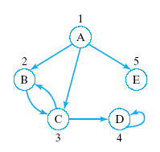
Graphs: Basic Definitions
Degree Of a Weighted directed Graph
Out-degree of vertex:
  Number of edges get out of it.
In-degree of vertex:
  Number of edges get into it.
Vertex | Out-Degree | In-Degree
A | 3 | 0
B | 1 | 2
C | 2 | 2
D | 1 | 2
E | 0 | 1

Slide 12
Graphs: Basic Definitions
A weighted graph
A weight is associated with each edge.
3
A
F
2
2
1
B
G
E
1
5
4
2
C
D
A Sub-Graph
A subset of vertices and edges.

Slide 13
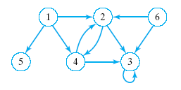
Graphs: Basic Definitions
Directed graph
Consists of a finite set of elements
  Vertices or nodes (6)
Together with finite set of directed
  Arcs or edges (10)
  Connect pairs of vertices
Tree is kind of directed graph

Slide 14
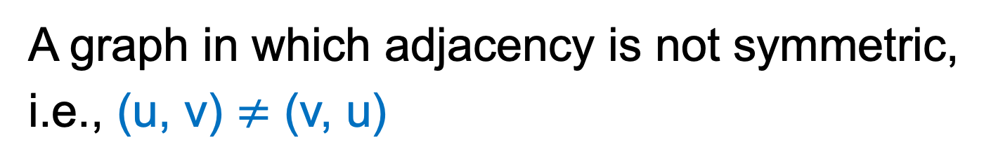
Graphs: Basic Definitions
Directed graph
A graph in which adjacency is not symmetric,
i.e., (u, v) $≠$ (v, u)
A
F
B
G
E
Also known as
“Digraphs”
C
D

Slide 15
Graphs: Basic Definitions
Directed weighted graph
A directed graph with a weight for each edge.
A
3
F
2
2
1
B
G
E
5
1
4
2
Also called a
“network”
C
D

Slide 16
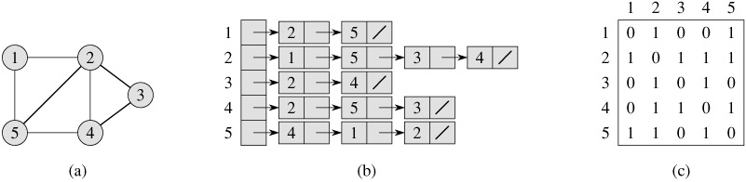
Graph representation – undirected
graph
Adjacency list
Adjacency matrix

Slide 17
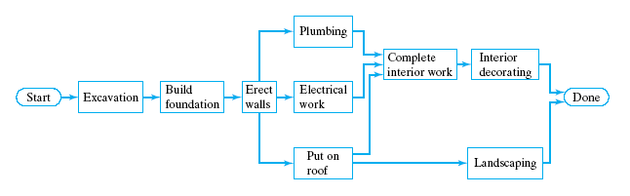
Directed Graphs
Applications of directed graphs
  Analyze electrical circuits
  Find shortest routes
  Develop project schedules

Slide 18
Directed Graphs
Trees are special kinds of directed graphs
  One of their nodes (the root) has no incoming arc
  Every other node can be reached from the node by a unique path
Graphs differ from trees as ADTs
  Insertion of a node does not require a link (arc) to other nodes … or may have multiple arcs
  Deletion operation may apply either to nodes or edges

Slide 19
Directed Graphs
A directed graph is defined as a collection of data elements:
  Called nodes or vertices
  And a finite set of direct arcs or edges
  The edges connect pairs of nodes
Operations include
  Constructors
  Inserts of nodes, of edges
  Deletions of nodes, edges
  Search for a value in a node, starting from a given node

Slide 20
Graph Representation
Adjacency matrix representation
  for directed graph with vertices numbered
  1, 2, … n
Defined as n by n matrix named adj
The [i, j] entry set to
  1 (true) if vertex j is adjacent to vertex i
  (there is a directed edge from i to j)
  0 (false) otherwise

Slide 21
Graph Representation
columns j
 | 1 | 2 | 3 | 4 | 5
1 | 0 | 1 | 1 | 0 | 1
2 | 0 | 0 | 1 | 0 | 0
3 | 0 | 1 | 0 | 1 | 0
4 | 0 | 0 | 0 | 1 | 0
5 | 0 | 0 | 0 | 0 | 0
rows i
Entry [ 1, 5 ] set to true
Edge from vertex 1 to vertex 5
Entry [ 1, 4 ] set to false
No Edge from vertex 1 to vertex 4

Slide 22
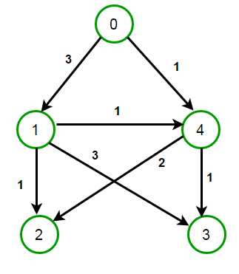
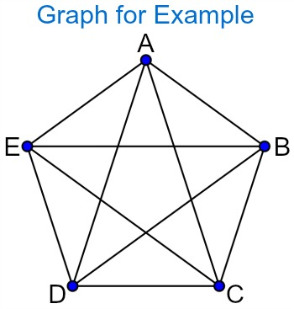
Graph Representation
Weighted digraph
  There exists a "cost" or "weight" associated with each arc
  Then that cost is entered in the adjacency matrix
A complete graph
  has an edge between each pair of vertices
  N nodes will mean N * (N – 1) edges

Slide 23
Adjacency Matrix
Consider the sum of the products of the pairs of elements from row i and column j
Fill in the rest of adj ²
adj
adj ²
 | 1 | 2 | 3 | 4 | 5
1 | 0 | 1 | 1 | 0 | 1
2 | 0 | 0 | 1 | 0 | 0
3 | 0 | 0 | 0 | 1 | 0
4 | 0 | 0 | 0 | 1 | 0
5 | 0 | 0 | 0 | 0 | 0
 | 1 | 2 | 3 | 4 | 5
1 |  |  | 1
2
3
4
5
This is the number of paths of length 2 from node 1 to node 3

Slide 24
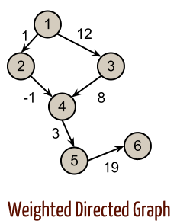
Example: Adjacency Matrix
Node | 1 | 2 | 3 | 4 | 5 | 6
1 | 0 | 1 | 12 | 0 | 0 | 0
2 | 0 | 0 | 0 | -1 | 0 | 0
3 | 0 | 0 | 0 | 8 | 0 | 0
4 | 0 | 0 | 0 | 0 | 3 | 0
5 | 0 | 0 | 0 | 0 | 0 | 19
6 | 0 | 0 | 0 | 0 | 0 | 0

Slide 25
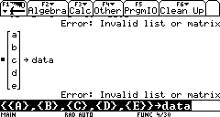
Adjacency Matrix
Deficiencies in adjacency matrix representation
  Data must be stored in
  separate matrix
  When there are few edges, the matrix is sparse
  (wasted space)
data =

Slide 26
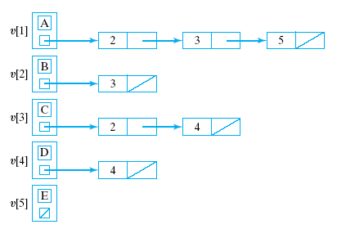
Adjacency-List Representation
Solving problem of wasted space
  Better to use an array of pointers to linked row-lists
This is called an
Adjacency-list
representation

Slide 27
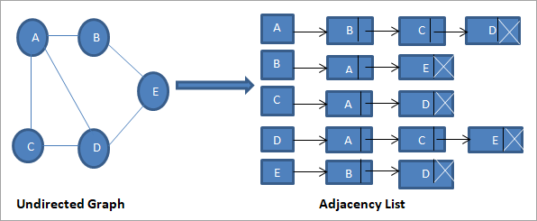
Example: Adjacency List

Slide 28
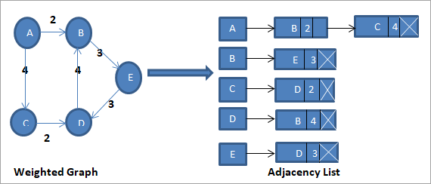
Example: Adjacency List

Slide 29
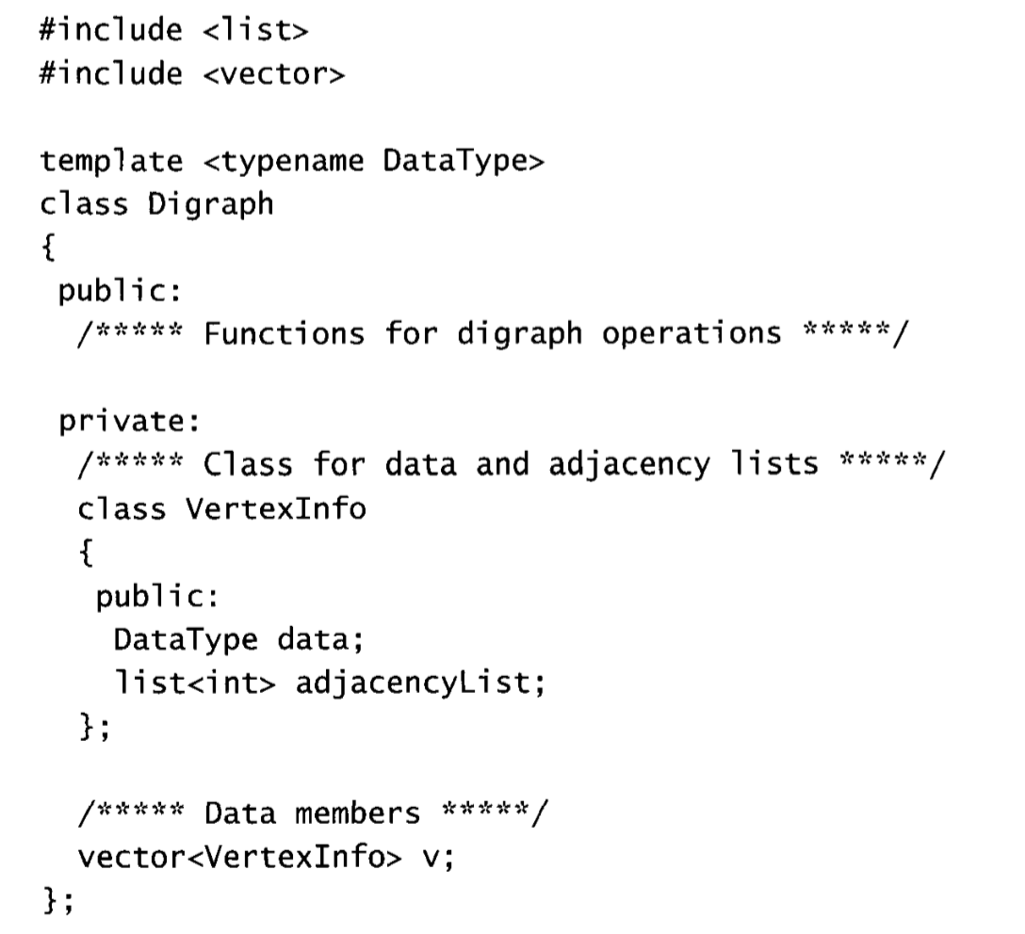
Adjacency-List class template

Slide 30
Searching a Graph
Recall that with a tree we search from the root
But with a digraph …
  may not be a vertex from which every other vertex can be reached
  may not be possible to traverse entire digraph
  (regardless of starting vertex)

Slide 31
Searching a Graph
We must determine which nodes are reachable from a given node
Two standard methods of searching:
  Depth First Search (DFS)
  Breadth First Search (BFS)

Slide 32
Depth-First Search (DFS)
Start from a given vertex v
Visit first neighbor w, of v
Then visit first neighbor of w which has not already been visited
etc. … Continues until
  all nodes of graph have been examined
If dead-end reached
  backup to last visited node
  examine remaining neighbors

Slide 33
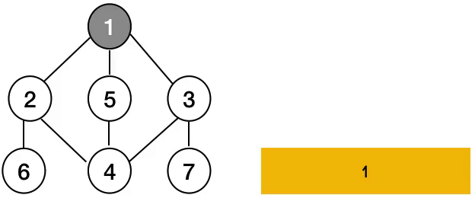

Depth-First Search (DFS)

Slide 34
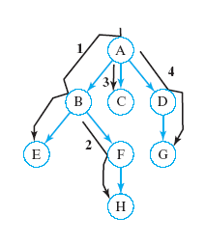
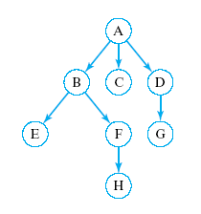
Depth-First Search
Start from node 1
What is a sequence of nodes which would be visited in DFS?
Click for answer
A, B, E, F, H, C, D, G

Slide 35
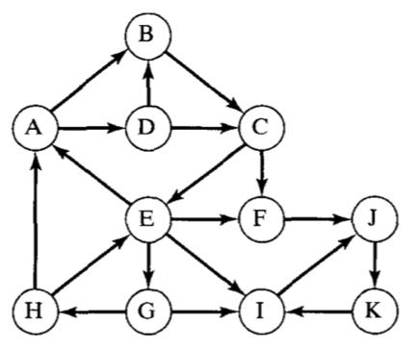
Example: Depth-First Search
Start from node A
What is a sequence of nodes which would be visited in DFS?
A→B →C →E →F →J →K →I →G →H →D
What if start from node K?

Slide 36
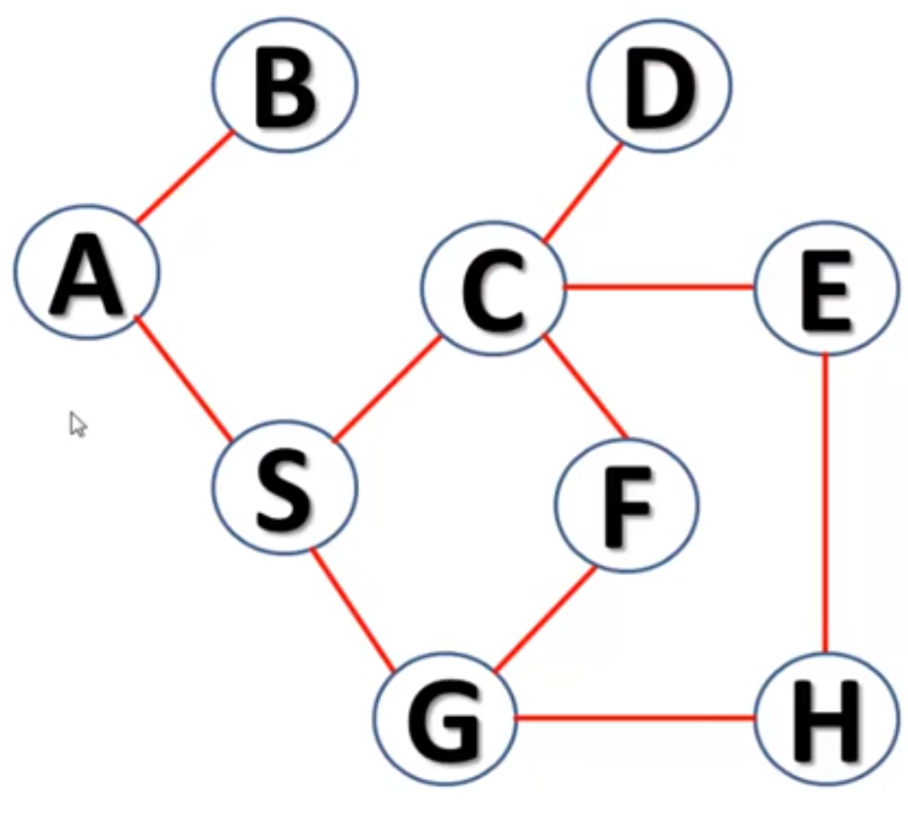
Example: Depth-First Search
A B S C D E H G F

Slide 37
Depth-First Search
DFS uses backtracking when necessary to return to some values that were
  already processed or
  skipped over on an earlier pass
When tracking this with a stack
  pop returned item from the stack
Recursion is also a natural technique for this task
Note: DFS of a tree would be equivalent to a preorder traversal

Slide 38
Depth-First Search
Algorithm to perform DFS search of digraph
1.
Visit the start vertex, v
2.
For each vertex w adjacent to v do:
If
w
has not been visited,
apply the depth-first search algorithm
with
w
as the start vertex.
Note the recursion

Slide 39
Breadth-First Search (BFS)
Start from a given vertex v
Visit all neighbors of v
Then visit all neighbors of first neighbor w of v
Then visit all neighbors of second neighbor x of v … etc.
BFS visits nodes by level

Slide 40
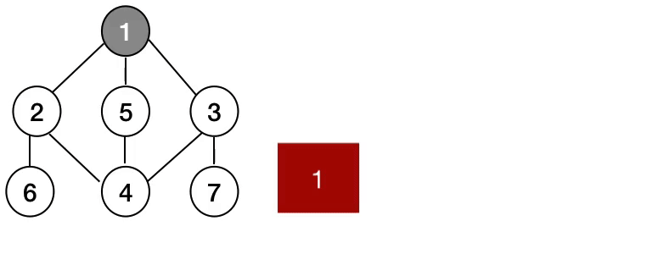
Breadth-First Search (BFS)

Slide 41
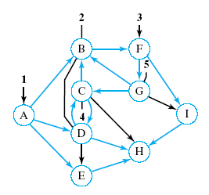
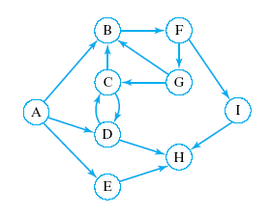
Breadth-First Search
Start from node containing A
What is a sequence of nodes which would be visited in BFS?
Click for answer
A, B, D, E, F, C, H, G, I

Slide 42
Example: Breadth-First Search
Start from node containing A
What is a sequence of nodes which would be visited in BFS?
A→B →D →C →E →F →G →I →J →H →K
If start from node G

Slide 43
Example: Breadth-First Search
A B S C G D E F H

Slide 44
Breadth-First Search
While visiting each node on a given level
  store it so that
  we can return to it after completing this level
  so that nodes adjacent to it can be visited
First node visited on given level should be
First node to which we return
What data structure does this imply?
A queue

Slide 45
Breadth-First Search
Algorithm for BFS search of a diagraph
Visit the start vertex
Initialize queue to contain only the start vertex
While queue not empty do
  Remove a vertex v from the queue
  For all vertices w adjacent to v do:
  If w has not been visited, then:
    Visit w
    Add w to queue
  End while

Slide 46
Graph Traversal
Algorithm to traverse graph must:
  visit each vertex exactly once
  BFS or DFS forms basis of traversal
  Mark vertices when they have been visited
Initialize an array (vector) unvisited
unvisited[i] true for each vertex i
While some element of unvisited is true do
  Select an unvisited vertex v
  Use BFS or DFS to visit all vertices reachable from v
  End while

